Slide 1

Lightweight Byzantine Detection for Resource-Constrained Federated Learning
Major Project
Submitted By - Abhishek Kumar Tripathi
Entry No - 2024EET2845
Guide - Prof Harshan Jagdeesh

Slide 2

Preview
FL Basics
1
Problem Statement
2
Existing Robust Aggregators
3
Client Behavior Detection
4
Status
5
References
6

Slide 3
Introduction

Slide 4


What is Federated Learning
4
Distributed ML : Clients train locally without sharing RAW data.
Global Objective:
Server aggregates updates.

Slide 5
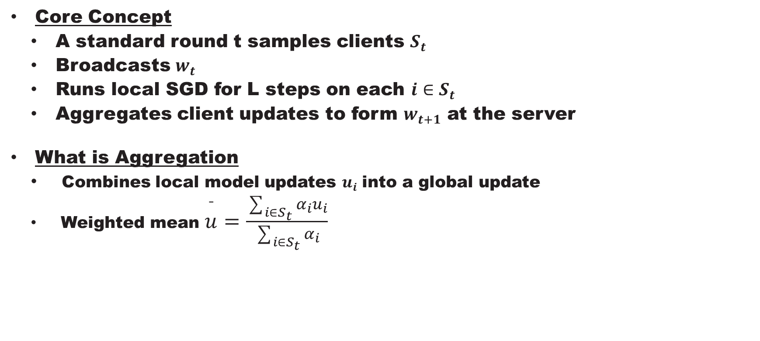
What is Federated Learning
5
Core Concept
  A standard round t samples clients $S_{t}$
  Broadcasts $w_{t}$
  Runs local SGD for L steps on each $i∈S_{t}$
  Aggregates client updates to form $w_{t+1}$ at the server
What is Aggregation
  Combines local model updates $u_{i}$ into a global update
  Weighted mean $\overset{ˉ}{u}=\frac{\sum_{i∈S_{t}}{α_{i}}u_{i}}{\sum_{i∈S_{t}}{α_{i}}}$

Slide 6
What is Federated Learning
6
Motivation:
  Outliers
  Noisy updates
  Malicious attacks
  Need robustness with privacy and low cost
Byzantine clients and attacks
  Participants that can send arbitrary vectors
  Their presence breaks plain averaging
  Robust rules compare updates and downweigh outliers

Slide 7
What is Federated Learning
7
Importance:
  Privacy: Raw data stays local.
  Efficiency: Less data transfer.
  Personalization: Clients can fine-tune models to their own needs.
  Collaboration: Enables cross-organization learning (like hospitals sharing knowledge without sharing patient data).

Slide 8
Problem Statement

Slide 9
Problem Statement
10
Motivation
Traditional Byzantine-tolerant algorithms are defense-based and sometimes fall short in the federated learning settings
Untargeted defense adopted in existing methods
Defending against the attackers at a cost of honest clients

Slide 10
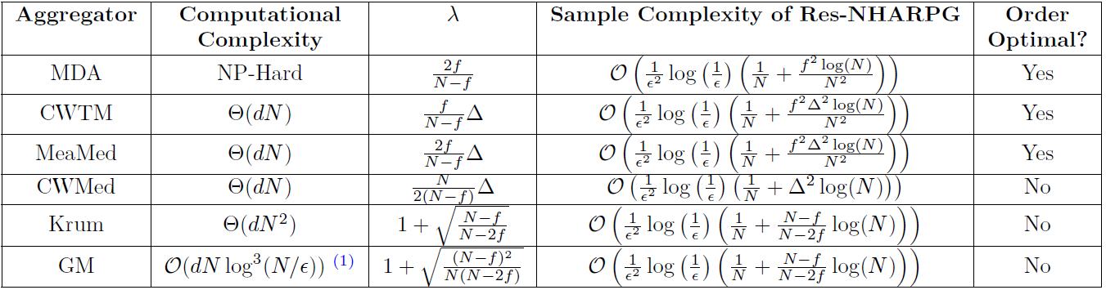
Problem Statement
11
Motivation

Slide 11
Problem Statement
12
Lightweight Byzantine Detection for Resource-Constrained Federated Learning
Let each device compute a local anomaly score against a server‑broadcast robust reference and send a flag/score via secure aggregation.
Focus on simple statistical and reputation-based tests that run on resource-constrained clients
Total Clients – N
Byzantine Clients, f < N/2
Federated learning collaboratively minimizes a global loss with
data kept local

Slide 12

Problem Statement
13
Lightweight Byzantine Detection for Resource-Constrained Federated Learning
Current server-side robust aggregation methods (Krum, geometric median) require high computational cost
  Krum $O\left(n^{2}d\right)$
  Geometric median $O\left(Tnd\right)$
  Mean $O\left(nd\right)$
  Where T- No of iterations, n – #clients, d- Model’s parameter dimension
Hence client‑side $O\left(d\right)$ scoring is attractive

Slide 13
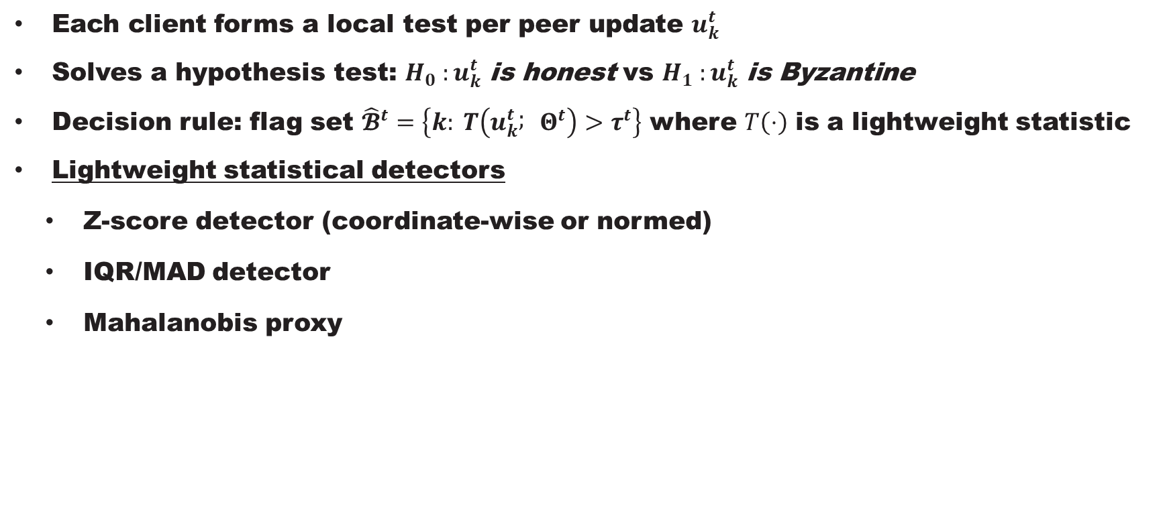
Detection Objective
15
Each client forms a local test per peer update $u_{k}^{t}$
Solves a hypothesis test: $H_{0} :u_{k}^{t} \text{is} \text{honest}$ vs $H_{1} :u_{k}^{t} \text{is} \text{Byzantine}$
Decision rule: flag set ${\hat{𝓑}}^{t}=\left\{k: T\left(u_{k}^{t} ; Θ^{t}\right)>τ^{t}\right\}$ where $T\left(⋅\right)$ is a lightweight statistic
Lightweight statistical detectors
  Z-score detector (coordinate-wise or normed)
  IQR/MAD detector
  Mahalanobis proxy

Slide 14
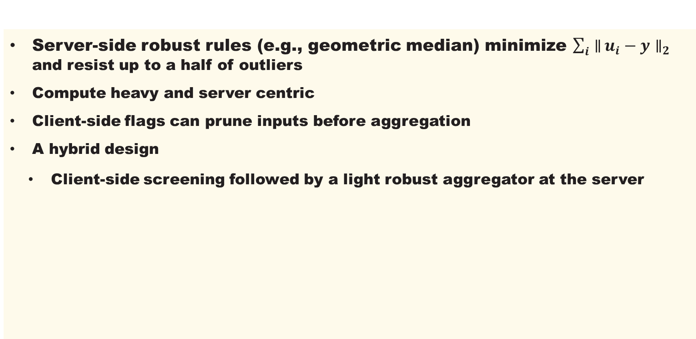
Relation to Robust Aggregation
16
Server-side robust rules (e.g., geometric median) minimize $\sum_{i}{∥}u_{i}−y∥_{2}$ and resist up to a half of outliers
Compute heavy and server centric
Client-side flags can prune inputs before aggregation
A hybrid design
  Client-side screening followed by a light robust aggregator at the server

Slide 15
AuthenticPeer: A Reputation Management System for
Peer-to-Peer Wireless Sensor Networks
17
Categories of reputation management systems:
  Peer based
  Message based
  Core Concept : Peer Based
  Peers gain a good or bad global trust value according to the quality of transactions they participate
  Malicious peers can change their identity if the system catches them, so their global trust values are erased, and they are considered as newcomers rather than malicious peers
  If a malicious peer is mistakenly chosen as a download source by a good peer, the former can spread inauthentic messages over the system through the latter

Slide 16
AuthenticPeer: A Reputation Management System for
Peer-to-Peer Wireless Sensor Networks
18
  Core Concept : Message Based
  The selection of a download source is based on the quality of the file instead of the quality of the peer
  Certain parameters are calculated for each file through several transactions before it can be identified as a trustworthy
  It takes time until the quality of a file is recognized
  Calculations of required parameters consumes system resources

Slide 17
AuthenticPeer: A Reputation Management System for
Peer-to-Peer Wireless Sensor Networks
19
  Core Concept : AuthenticPeer
    Check message trustworthiness before the peer
    Restricts malicious peers from distributing bad messages
  Calculating the trust and reputation values based on peer quality rather than the message quality until the quality of the file is revealed
  Message-based approach is only used when the message trust value is known, based on previous transactions.

Slide 18
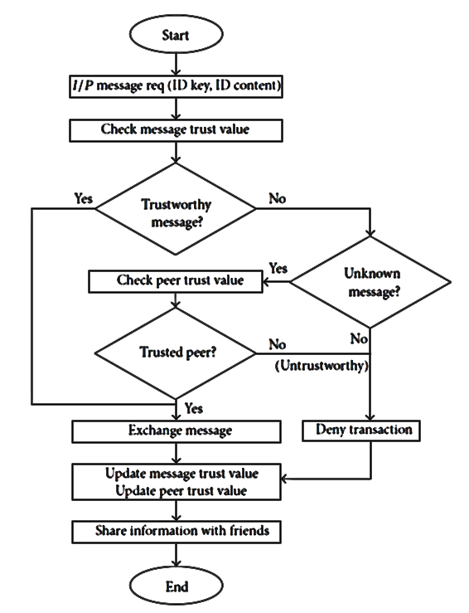
AuthenticPeer: A Reputation Management System for
Peer-to-Peer Wireless Sensor Networks
20

Slide 19

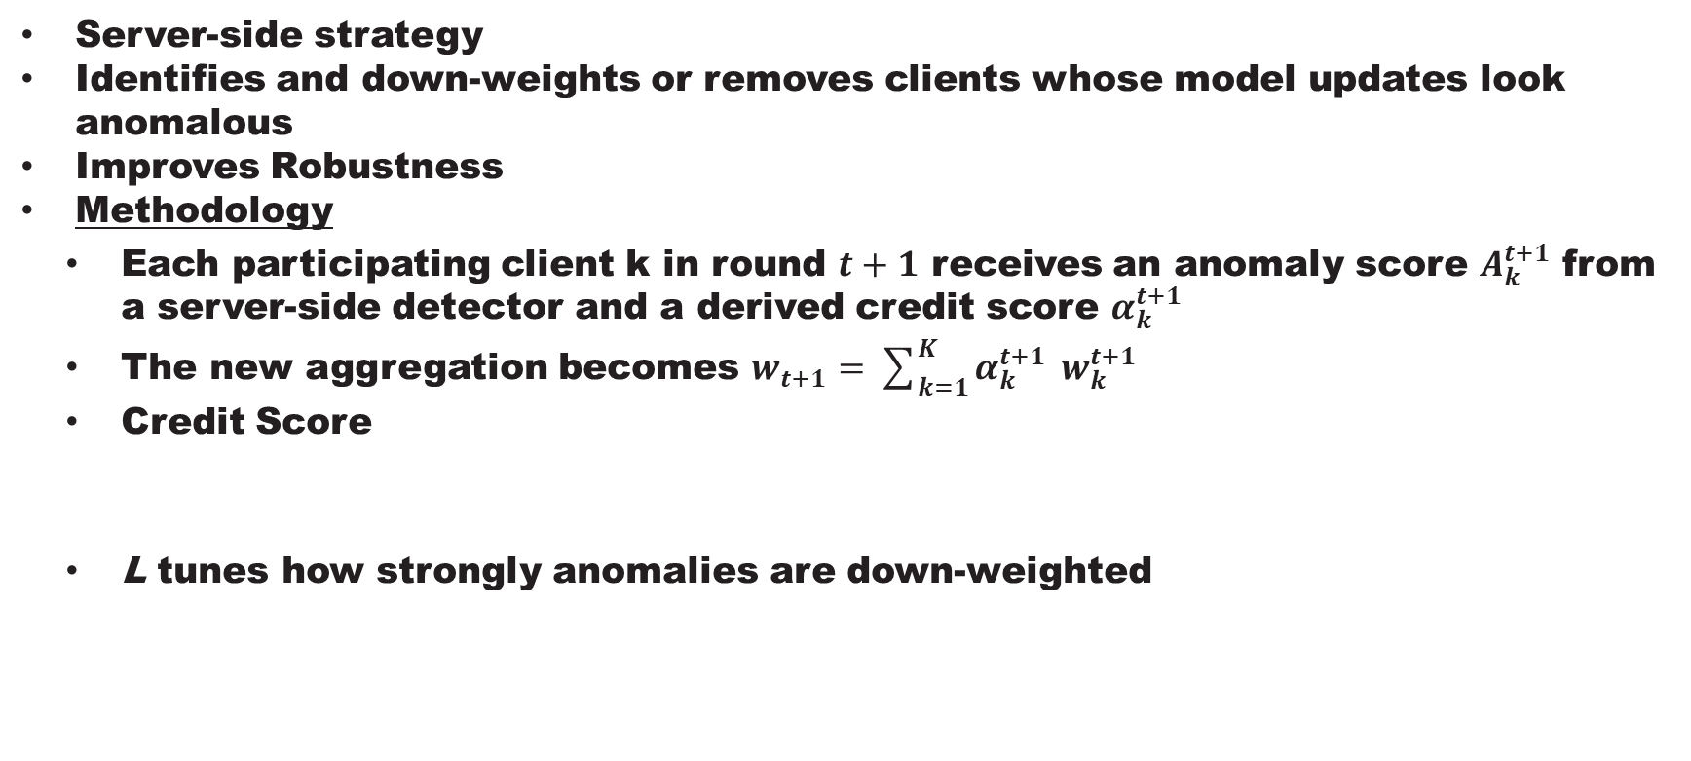
Abnormal Client Behaviour Detection
21
Server-side strategy
Identifies and down-weights or removes clients whose model updates look anomalous
Improves Robustness
Methodology
  Each participating client k in round $t+1$ receives an anomaly score $A_{k}^{t+1}$ from a server-side detector and a derived credit score $α_{k}^{t+1}$
  The new aggregation becomes $w_{t+1}=\sum_{k=1}^{K}{α_{k}^{t+1}} w_{k}^{t+1}$
  Credit Score
  L tunes how strongly anomalies are down-weighted

Slide 20



Abnormal Client Behaviour Detection
22
Autoencoder detector
  Reconstructs each incoming update surrogate and assigns an anomaly score proportional to its reconstruction error relative to the minimum error observed in that round
  Anomaly Score

Slide 21
Status

Slide 22
Status
25
Ongoing Research:
  Different attack suit (sign-flip, model-replacement, Gaussian noise, collusion)
  Baselines (mean, coordinate-wise median/trimmed mean, Krum/Multi-Krum, geometric median/RFA)
  Statistical tests on peers

Slide 23
References
24
K. Pillutla, S. M. Kakade, and Z. Harchaoui, “Robust Aggregation for Federated Learning,” IEEE Transactions on Signal Processing, vol. 70, 2022
H. B. McMahan, E. Moore, D. Ramage, S. Hampson, and B. Agüera y Arcas, “Communication-Efficient Learning of Deep Networks from Decentralized Data,” in Proceedings of the 20th International Conference on Artificial Intelligence and Statistics (AISTATS), Proceedings of Machine Learning Research, vol. 54, 2017
J. Geiping, H. Bauermeister, H. Dröge, and M. Moeller, “Inverting Gradients — How Easy Is It to Break Privacy in Federated Learning?,” arXiv:2003, 2020
S. Ganesh, J. Chen, G. Thoppe, and V. Aggarwal, “Global Convergence Guarantees for Federated Policy Gradient Methods with Adversaries,” Transactions on Machine Learning Research (TMLR), 2024
S. Li, Y. Cheng, Y. Liu, W. Wang, and T. Chen, “Abnormal Client Behavior Detection in Federated Learning,” in Proceedings of the 2nd International Workshop on Federated Learning for Data Privacy and Confidentiality (FL-NeurIPS 2019), 2019

Slide 24
Use cases
24
Tactical perception: vehicles, UAVs, and soldier handhelds co‑train object detection at the edge without centralizing sensitive data, improving local models under data scarcity
Communications and spectrum: radios collaboratively learn channel selection and jamming avoidance policies while keeping signals on‑device, which suits contested and D‑DIL (Denied, Disrupted, Intermittent, Limited) conditions
Collaborative spectrum sensing and anti‑jamming policy learning among tactical radios uses FL with local anomaly checks to isolate spoofed or hijacked emitters

Slide 25
Thank you

